Slide 1
Predicting stock market movement using sentiments
For EECSE 6898-From Data to Solutions class
Presented by-Tulika Bhatt(tb2658)

Slide 2
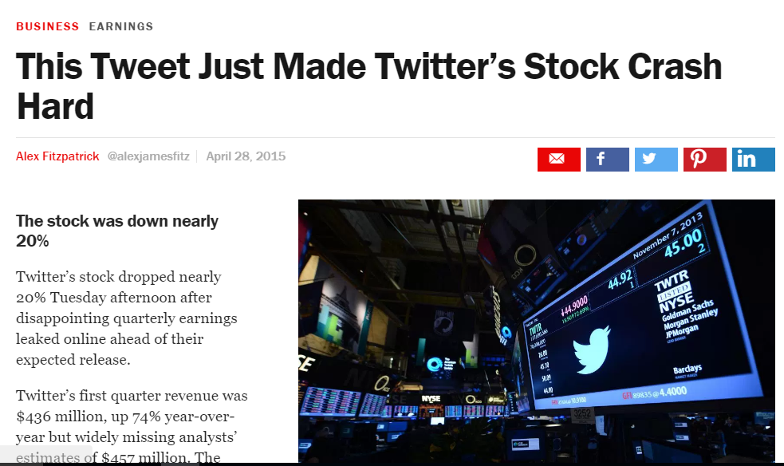
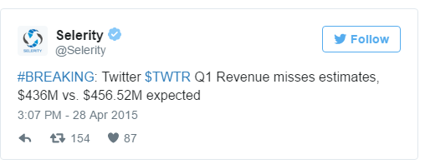
Notes:
[1]
Selerity : Selerity is the first contextual content recommendation company for enterprise applications. We deliver high-quality, personalized content that is engaging and actionable optimized for business professionals in specific verticals such as finance.

Slide 3
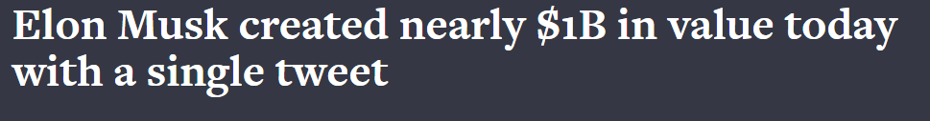
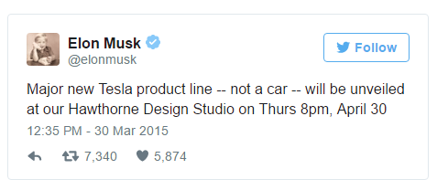


Slide 4
What do stock prices depend on?
Fundamental Factors
-Earning base
-Valuation Multiple
Technical Factors
-Inflation, Economic Strength of Market and Peers, Substitutes, Incidental Transactions, Trends, Demographics, Liquidity
Market Sentiments

Slide 5
proposal
To find out the relation between sentiments expressed in news articles and tweets vs the stock market movement
Identify the which type of news articles affects the stock prices the most
Identify users in social media who influence the sentiment for an organization

Slide 6



NOVELTY
New startups are cropping up which use sentiment analysis on Twitter Data to predict stock market movement.
Several research papers in market which use sentiment analysis to predict the movement of stock market price.
S. Shen, H. Jiang, and T. Zhang, Stock Market Forecasting Using Machine Learning Algorithms.
Nuno Oliveira, Paulo Cortez, and Nelson Areal, On the Predictability of Stock Market Behavior Using StockTwits Sentiment and Posting Volume

Slide 7
approach
Collect real time and historical data about top fifteen companies from NASDAQ and NYSE
Get the difference between the stock price at the end of the market on two consecutive days.
Apply classification methods like Logistic Regression, Decision Tree, SVC and KNN to estimate the movement of the change in stock market price vs the volume as well as sentiment of news articles and tweets.
Apply Linear Regression to find relation between the change in stock market price vs the volume as well as sentiment of news articles and tweets.
Attempt Entity level sentiment analysis on the tweets and the news reports to find sentiments associated with each organization entity

Slide 8

Data Sources
Tweets from StockTwits
News articles from
IBM Alchemy Data News API
The Guardian API
NYTimes Article Search API

Slide 9
DATA Sources
Stock Information:
Google Finance API
Provides no delay, real time stock data in NYSE & NASDAQ
Yahoo Finance API
The updates are 15 minutes late but provides historical day-by-day stock data.

Slide 10
Evaluation of result
Measure correlation between
Volume of tweets vs change in stock price
Sentiment of tweets vs change in stock price
Volume of news articles vs change in stock price
Sentiment of news article vs change in stock price
Mean Squared Error for Linear Regression Model
Loss function and accuracy percentage for Classification models

Slide 11
References
[1]“This Tweet Just Made Twitter’s Stock Crash Hard | TIME.” [Online]. Available: http://time.com/3839011/twitter-earnings-results/.
[2]“Forces That Move Stock Prices | Investopedia.” [Online] Available:http://www.investopedia.com/articles/basics/04/100804.asp.
[3]“Support Vector Machines for Classification and Regression - SVM.pdf.” [Online]. Available: http://trevinca.ei.uvigo.es/~cernadas/tc03/mc/SVM.pdf.
[4]S. Shen, H. Jiang, and T. Zhang, Stock Market Forecasting Using Machine Learning Algorithms.
[5]Nuno Oliveira, Paulo Cortez, and Nelson Areal. Progress in Artificial Intelligence: 16th Portuguese Conference on Artificial Intelligence, EPIA 2013, Angra do Hero´ısmo, Azores, Portugal, September 9­12, 2013. Proceedings, chapter On the Predictability of Stock Market Behavior Using StockTwits Sentiment and Posting Volume, pages 355–365. Springer Berlin Heidelberg, Berlin, Heidelberg, 2013

